Slide 1
Cat People vs Dog People
By Tess Johnson

Slide 2
Which are you?
Many people identify as either a “dog person” or a “cat person”.
What is the difference?
How can you tell if you are a dog person or a cat person?

Slide 3
Which are you?
Let’s explore the traits of dogs and cats to see if your personality matches that of a dog or a cat.

Slide 4
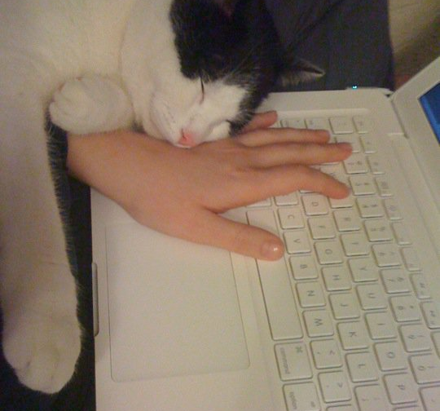
Cat Traits
Cats make a point to let you know that your affection is unnecessary – until your hands or lap is full and unable to accommodate them.

Slide 5
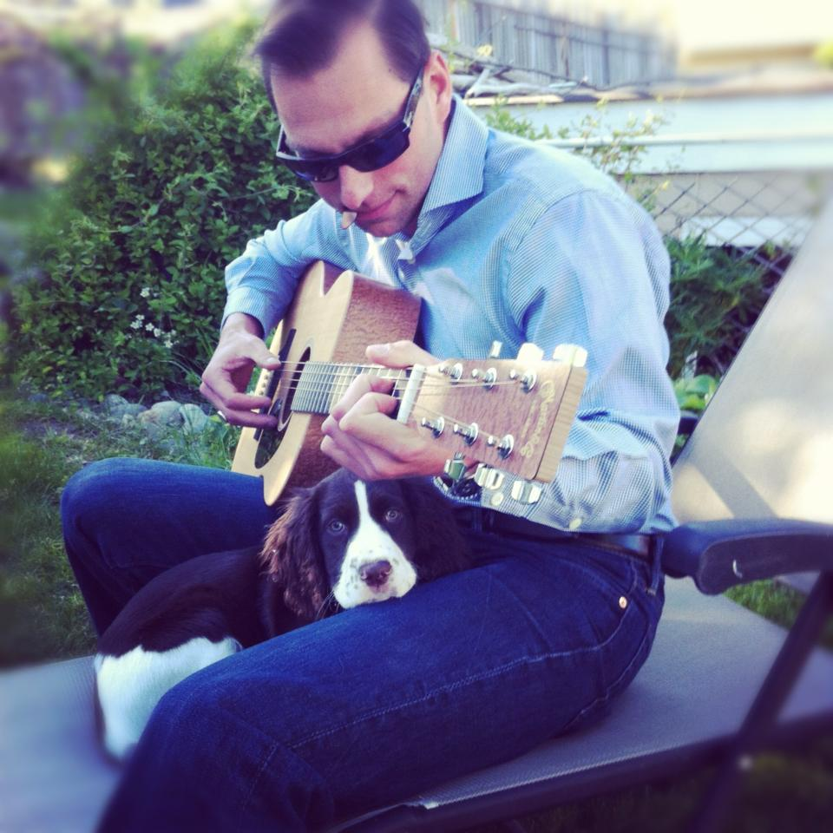
Dog Traits
Dogs tend to be more sociable than cats. They enjoy and seek out affection from their owners often.

Slide 6
Personality Traits
Cat People
Dog People
Creative
Curious, intelligent
Worrier
Energetic
Faithful
Sociable, friendly

Slide 7
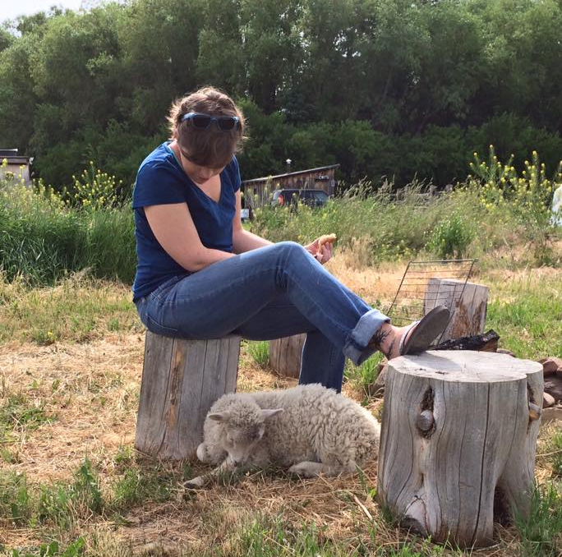
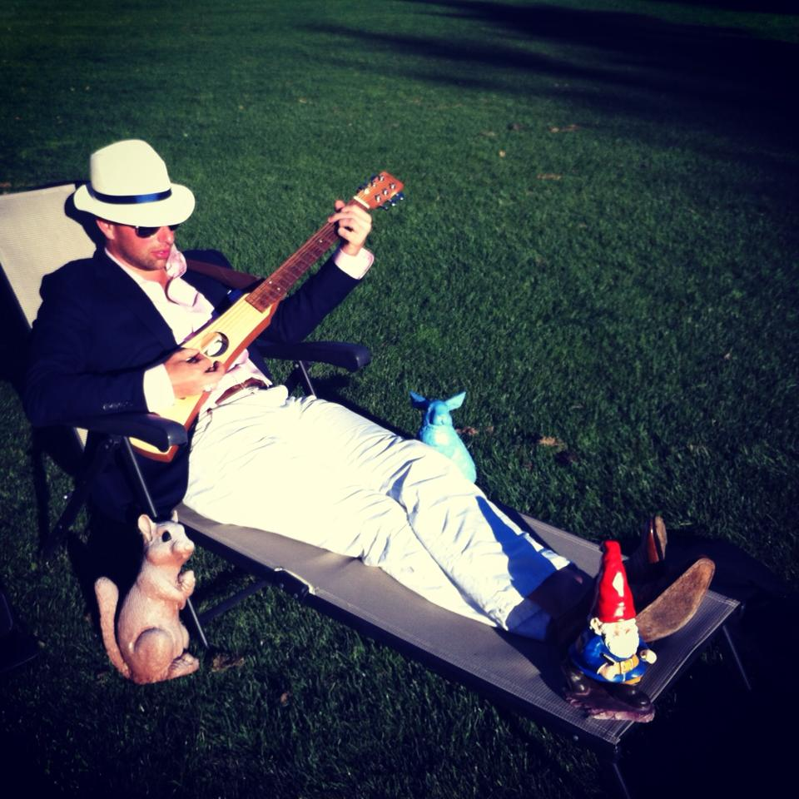
Don’t fit the mold?
Maybe you’re a lamb person!
Maybe you’re a squirrel and gnome person!

Slide 8
Regardless, let’s all be friends!

