Slide 1
CHAPTER 2
Ideas

Slide 2
Chapter 2 Ideas
“The ones with eyelashes are girls; boys don’t have eyelashes.”
—Four-year-old Erin describes her drawing
Copyright © 2019 W. W. Norton & Company
Notes:
[chapter opener]

Slide 3
Chapter 2 Outline
The Binary and Our Bodies
Gender Ideologies
The Binary and Everything Else
Notes:
This is the chapter outline, which gives us some idea of how gender is structured in our society. Although often invisible to us, the gender binary and ideologies constrain and shape our behavior, our beliefs, and even our life choices.

Slide 4
Q & A
If we don’ t learn the idea of the gender binary by
observing the people around us, where does the idea
come from?
Notes:
One of the main questions the chapter poses is how we learn the gender binary, which is part of the hidden curriculum of our lives. It is taught and reinforced in so many aspects of our lives. If you have taken introductory sociology, you know that we have agents of socialization in our lives that have a great deal of influence in our development of ideas, values, beliefs, and identity.
Can you name any of the agents of socialization in your life? (Answers can include parents, school, the media, and so on.)

Slide 5
Opposite Sex?
We tend to use the word “opposite” when describing the relationship between men and women.
Why don’t we say “the other sex”?
Seventeenth-century Europeans and early Americans believed in superior and inferior versions of personhood.
Women were inferior, with penises and testes “turned inside out.”
Notes:
We shape the dynamics between men and women in a negative way when we see our self and an opposite; it becomes a case of us versus them in a number of subtle and obvious ways.
Why don’t we say the other sex instead of the opposite sex?

Slide 6
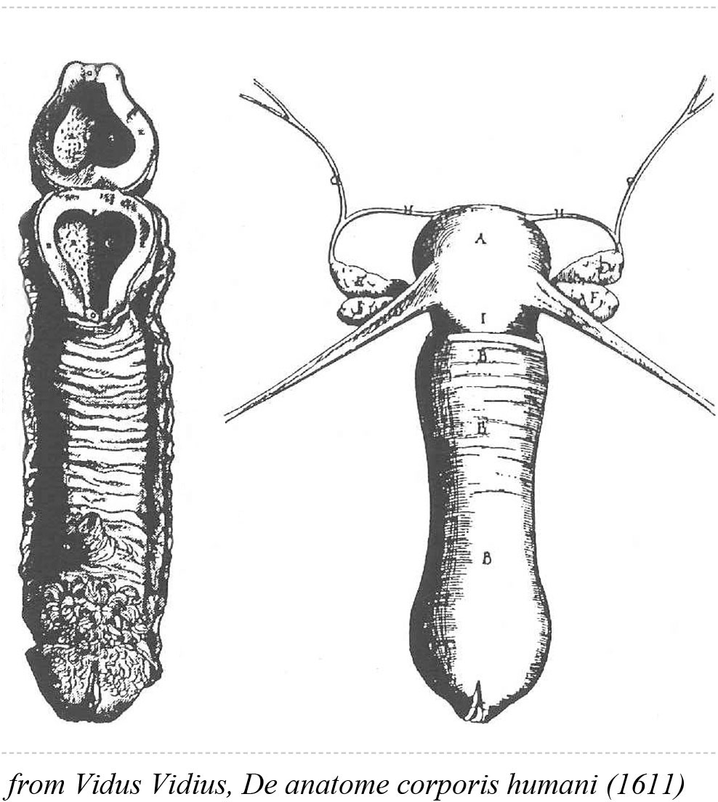
Opposite Is Not Accurate
“Opposite” suggests that what one sex is, the other is not, and this is not entirely true.
Male and female anatomy do have similarities and develop from the same fetal tissue.
Figure 2 .1 | 17th century illustration of the vagina and uterus
Notes:
Our bodies are all human, developing from the same blob of tissue, modified to enable sexual reproduction. So while it is not accurate to say there is only one sex, neither is it perfectly correct to say men and women are opposites.

Slide 7
The Gender Binary
Men and women have more similarities than differences, and we both have strengths and weaknesses.
The gender binary argues that there are only two types of people, male-bodied people, who are masculine, and female-bodied people, who are feminine.
Because we tend to think in terms of a gender binary, we routinely group men together as if they’re all alike, and likewise for women.
Notes:
What’s wrong with this ideology?
How many of you do not fit neatly into this gender binary?

Slide 8
The Personal Exception Theory
This tendency to categorize people according to the gender binary results in some stereotyping.
A large number of us don’t believe we, personally, conform to a stereotype; we are personal exceptions.
When we stop and think about it, we realize that many of the people we know well don’t fit into the stereotypes either.
Notes:
Thus, we can become personal exceptions to the rule, uniquely ourselves, feminine or masculine, but not always.
Can you give some examples of ways in which you do not always fit the binary?

Slide 9
Gender Socialization
With our socialization, we put people and things into masculine and feminine categories without thinking about it; this seems natural rather than constructed.
Gender is a logic that we manipulate, but it also manipulates us.
Gender provides a framework in which we can understand our world, but it is a limited worldview.
Notes:
Our socialization makes us so skilled at layering ideas about gender onto the world that we have a hard time seeing it for what it really is. We don’t always notice when gender stereotypes fail to make sense.

Slide 10
The Binary and Our Bodies
Since we realize that we are more than our bodies, our tendency to categorize based on bodies is flawed.
People with androgen insensitivity are born with genitalia that may not fit typical definitions of female or male.
People with intersex bodies are living proof that not everyone fits into a gender binary that allows only for opposite sexes.
Notes:
People who are intersex remind us that while we tend to take for granted that everyone is clearly male or female, the path to such a straightforward body involves many complicated steps.

Slide 11
Table 2 .1 | STEPS TOWARD BECOMING A “MAN ” OR A “WOMAN ” IN THE UNITED STATES
Notes:
Table 2.1 provides a clear overview of the steps to becoming male-bodied or female-bodied.

Slide 12
Gender Identity
Becoming a “man” or “woman” in the United States today, involves more than just physical development.
Our gender identities are about who we feel we are in the world; how we identify may not be consistent with societal expectations for our gender.
Notes:
Most of us assume that one’s body, gender identity, and gender expression will all “line up,” but sometimes they don’t.

Slide 13
Gender Expression
Most of us also learn to communicate our gender identity through our appearance, dress, and behavior. This is our gender expression.
Our bodies, gender identity, and gender expression do not always match.
It is estimated that one out of every hundred people is intersex and more than one in ten report feeling as masculine as they do feminine, or more gender atypical than typical.

Slide 14
The 10 Percent
We all probably know at least one intersex person, and we probably don’t know who they are.
Some people with intersex bodies may not know it unless a health problem emerges.
Some intersex conditions are chromosomal, and others are caused by cell anomalies or hormones.

Slide 15
Intersex Infants and the Binary
Concern about the consequences of violating the gender binary has resulted in parents or physicians choosing genital surgical changes for intersex infants.
However, intersex activists have influenced some doctors to delay surgery until children with intersex bodies are old enough to decide for themselves.
The practice of choosing genital surgery for intersex infants continues because of our discomfort with bodies we see as deviating from what we see as normal.
Notes:
Having a child who does not “fit in” is a source of concern for most parents.
What consequences might parents want to avoid for their children by having surgery performed during infancy?

Slide 16
Transgender and Nonbinary
Another group of people whose gender identity does not conform to the gender binary are called transgender.
Many transgender people experience some form of gender dysphoria, which is a discomfort with the relationship between their bodies’ assigned sex and their identity.
Some trans people identify as men or women, others identify as trans men or trans women, and others as nonbinary, meaning they are outside or between the male/female binary (also described as genderqueer).

Slide 17
Pronouns and Identity Choices
Some trans people choose to change their bodies with surgical and hormonal treatments; others do not, for a variety of reasons.
Some trans, genderqueer, gender-fluid, and nonbinary people prefer the pronouns he/him and she/her, and others prefer gender neutral pronouns like the singular they/them or ze/zir.
Sometimes people change their gender identity as they evolve, or they are gender fluid, without a fixed gender identity.
Notes:
What are some reasons why some trans people do not choose surgery and hormone treatments?
Can you recall some examples from the book of increasing acceptance of nonbinary gender identities?

Slide 18
Danica Roem
Danica Roem is a singer in a death metal band and the first openly transperson to be elected and serve in a U.S. state legislature.
Notes:
In what ways do you think the trans community is most visible?

Slide 19
The 90 Percent
The term cisgender is increasingly used to refer to male- and female-bodied people who comfortably identify and express themselves as men and women, respectively.
The idea of oppositeness in males and females helps to police the boundaries of femininity and masculinity by emphasizing the differences.
Can you share some examples of people “policing” individuals whose behavior violates gender norms?
Notes:
Can you share some examples of people “policing” individuals whose behavior violates gender norms?

Slide 20
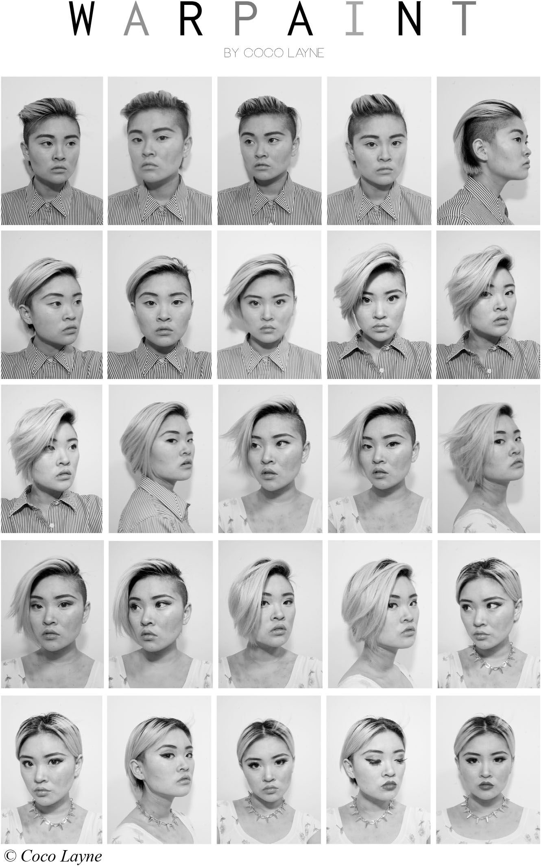
“Warpaint”
In her “Warpaint” project, artist Coco Layne shows how she transitions from appearing male to appearing female by way of her hairstyle, makeup, and clothes.
Notes:
Coco Layne’s art exhibit gives a visual example of the transition from male appearing to androgynous and then to female appearing.
What was your reaction when you looked at the different faces of the artist?

Slide 21
The 90 Percent, Continued
Even for physical characteristics in which there is a clear gender difference, there is a lot of overlap in male and female bodies.
Male and female physical traits such as height, hairiness, shape, strength, agility, flexibility, and bone structure overlap more than differ.
Cisgender people believe in the binary so much that they create differences by changing their bodies, style of dress, physical movement, and so on to emphasize their femininity or masculinity.
Notes:
What are some ways in which we manipulate our bodies to meet the gender binary expectations?

Slide 22
Ideology Defined
Ideology
A set of ideas widely shared by members of a society that guides identities, behaviors, and institutions
Gender Ideology
Widely shared beliefs about how men and women are, and should be, and how they do, and should, behave
Notes:
What are some reasons why we want to embrace societal ideologies?
What are some dangers in shared belief systems?

Slide 23
Gender Ideologies
The gender binary is just one of many ways of thinking about gender.
Some societies or cultures believe there are more than just two genders, or they see gender as more fluid.
The Navajo have a fifth, gender-fluid category for a person whose gender is constantly changing, a nádleehì.

Slide 24
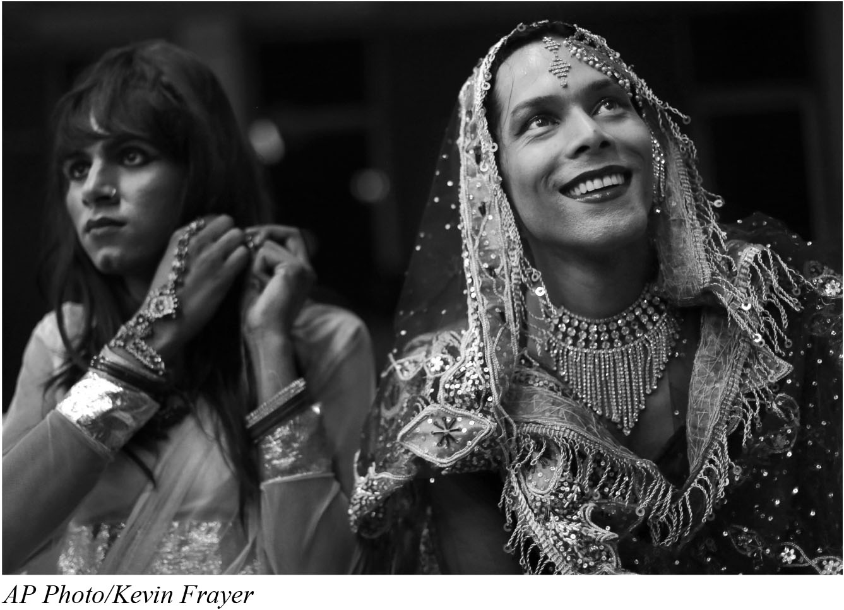
Sex-Switching
In India and Bangladesh, hijra is a third sex that is recognized by both governments and used in official documents.
Each of these cultures conceptualizes and defines the categories they recognize differently along with the role nonbinary people play.
In some places, strict social rules lead to the acceptance of temporary or permanent sex-switching.
Sex-switching occurs when biological girls become social boys.

Slide 25
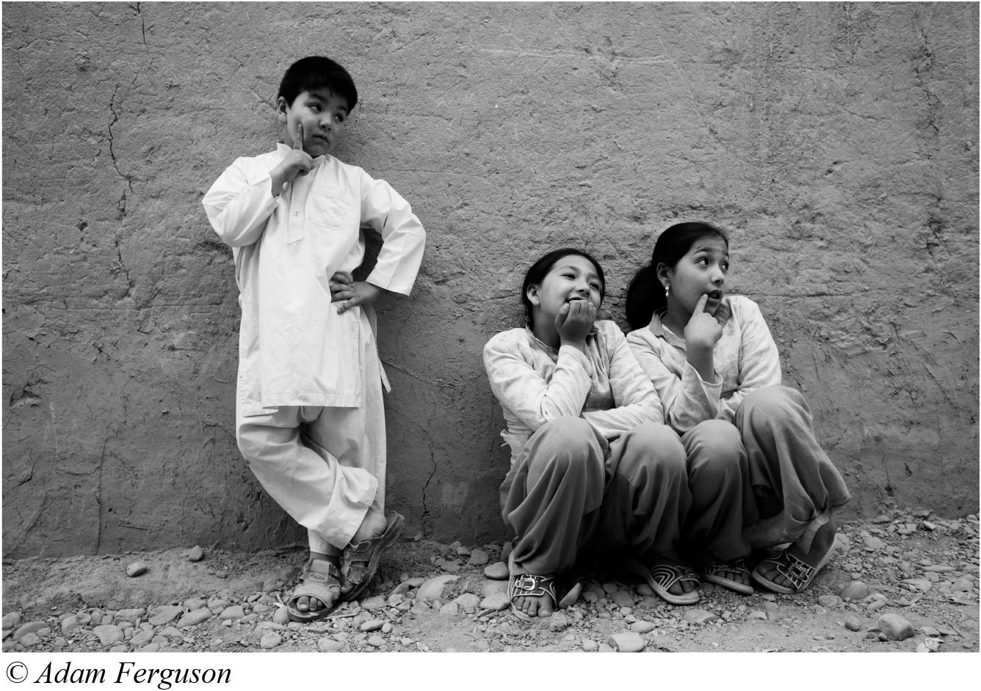
Sex-Switching, Continued
In Afghanistan where biological girls (and women) are not allowed to leave their homes without a male family escort sex-switched children are accepted.
This child (called a bacha posh) leaves the home as a male to attend to family business and grocery shopping that the female family members are not allowed to do.
When the child reaches puberty, she becomes a female again and a younger sister may take over the responsibility.
Notes:
Sex-switching has been found in various cultures throughout history, allowing for fluidity and change, both functionally within society and personally, within the individual.

Slide 26
Differing Definitions of Gender
Genitals don’t always determine one’s gender.
Our sexed bodies are real, but gender ideologies can vary, leading us to interpret our bodies, and our feelings about them, differently according to the social context.
The Western tendency to impose this binary on our bodies also applies to almost everything else.
Notes:
When we say that we impose this binary on things other than our bodies, we can consider how we gender objects, animals, styles of dress, and so on.

Slide 27
The Binary and Everything Else
Gender is a social construction, rather than natural, as we may assume.
Just as we apply rules to ourselves and others in support of the gender binary, we also apply gender labels to objects, activities, and even ideas.
Sociologists use “gender” as a verb when talking about the process by which something becomes coded as masculine or feminine.
We sometimes say something is “gendered "or that we “gender.”

Slide 28
Gendering
In associating things with a gender, we lump together as masculine or feminine collections of things that are not necessarily connected.
The gender binary also causes us to falsely disconnect masculine ideas from feminine ones, making it harder to form connections between them.
Notes:
In what ways might this disconnect be harmful to men or women?

Slide 29
Gender Binary Glasses
Our gender binary glasses help us see the world the way most other people around us do, but they also help preserve the binary itself.
We actively use our glasses, other words, to gender the world around us.
Socially trained brains help us get along with others whose brains are similarly trained.
Thus, our gender binary glasses give us cultural competence, which is a familiarity and facility with how the members of our society typically think and behave.
Notes:
There are some aspects of society and the relationships between the people in them that are proscribed by our gender binary and our gender binary glasses allow us to see the world through that shared social lens. This gives us a sense of belonging and shared meaning.
How might the gender binary and gender binary glasses affect those who are new to our culture or whose worldview is different?

Slide 30
Gendering Examples
Associative memory is the way cells in our brains process and transmit information to make literal connections so that some ideas are associated with other ideas in our minds.
Examples of associative memory operating within the gender binary:
Cats (feminized) versus dogs (masculinized)
Housework (feminized) versus yardwork (masculinized)
A perception of men as rational and women as emotional
Women as caregivers and men as breadwinners
Notes:
Can you think of other examples of the way we gender things, traits or ideas?
Encourage the students to take the Implicit Association Test (IAT).

Slide 31
Stereotypes
Another term for embedded associations is stereotypes; these are fixed, oversimplified, and distorted ideas about categories of people.
Since labeling and categorizing things are a huge part of our socialization, stereotyping is as well, even when we resist stereotypes.
Our gender binary glasses allow us to view the world the way the people around us do, but they also can distort our vision.
Notes:
Stereotypes are often based on real facts that become generalized to apply to whole groups or get distorted.
What stood out for you in the author’s discussion of stereotypes?

Slide 32
Conclusion
Gender stereotypes fail to describe most of the people we know, including ourselves.
Our gender binary glasses constrain our worldview.
Notes:
We now have come back to the original question that the chapter posed; is your answer different now than it was when you started the chapter?

Slide 33
Clicker Question 1
Stereotypes are so powerful that they are a source of
elimination of the gender binary.
false memories.
social construction.
none of the above.
Notes:
B: false memories.

Slide 34
Clicker Question 2
Which one of the following words best describes a cisgender woman?
feminine
lesbian
normal
asexual
Notes:
A. feminine

Slide 35
Clicker Question 3
Which of the following classifications rejects gender as binary or even a valid category?
homosexual
heterosexual
genderqueer
feminist
Notes:
C. genderqueer

Slide 36
Clicker Question 4
Which one of the following statements is a definition of gender ideology?
a universal way of thinking about gender
a legal definition of masculinity and femininity
a set of ideas widely shared by members of a society that guides identities, behaviors, and institutions
none of the above
Notes:
C. a set of ideas widely shared by members of a society that guides identities, behaviors and institutions

Slide 37
Clicker Question 5
In which of the following countries do the virgjinesha, or “sworn virgins,” originate?
Albania
Greece
Russia
Afghanistan
Notes:
A. Albania

Slide 38
Credits
This concludes the Lecture PowerPoint for Gender, 2nd Edition, Chapter 2: Ideas
For more resources, please visit http://digital.wwnorton.com/gender2

