Slide 1
WEEK 5
YOUR BRAIN ON STRESS

Slide 2
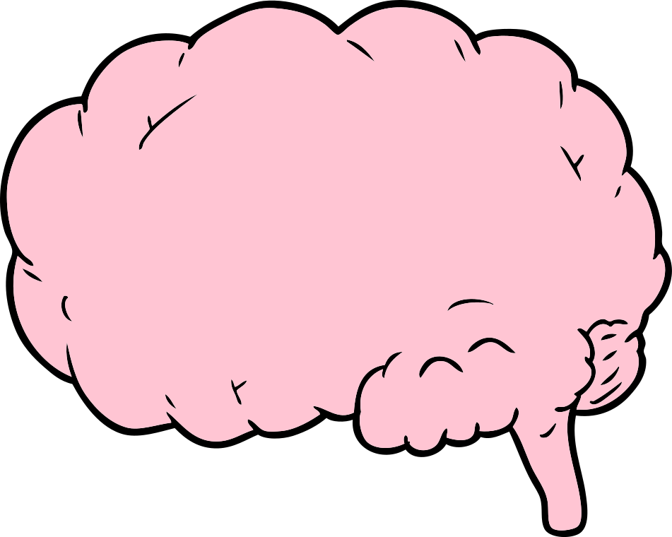
Stress and learning
Sensory information enters the brain and is filtered into one of two areas:
1. Pre-frontal cortex
2. Lower, automatic brain
What?

Slide 3
How this impacts you:
Because the amygdala routes information based on emotional state, un-managed stress can hijack the brain's ability to process and comprehend course material.
So my brain decides what to prioritize based on my feelings?

Slide 4
Causes of stress
Use the worksheet provided to identify and list your stressors.
This is for your eyes only.
Ughhh, where do I even begin?

Slide 5
Preventing and managing stress
- Identify your sources of stress & triggers
- Focus on what you can control
- Balance your time & stay on top of your course material
- Choose productivity over procrastination
- Speak with someone you trust (i.e., CAPS)
- Practice self-care
- Be in the present moment
- Wellness: exercise, proper nutrition & sleep
- Process your day – write about your stress
Looks like I've got some boundaries to set.

