Slide 1
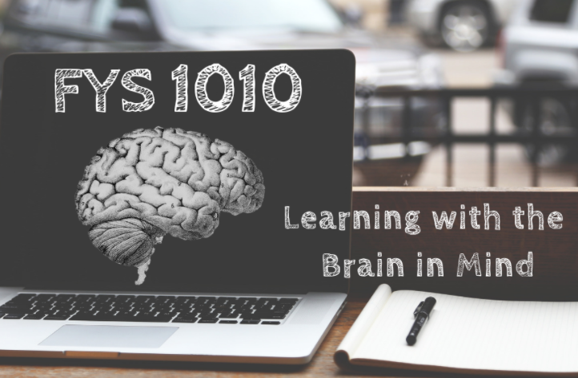
You @ WSU: Simplifying for Success

Slide 2
FYS CULTURE
Collaborative
Evidence-based
Inclusive
Performance enhancing
Safe space

Slide 3
THE TREND
LEARNING PERFORMANCE
At the end of the semester, 98% of FYS students reported learning beneficial test-taking strategies from the FYS curriculum
98% of students report upon completion of FYS that they have learned specific techniques to both prevent and manage stress
99% of students report upon completion of FYS that they know how to create an effective study schedule

Slide 4
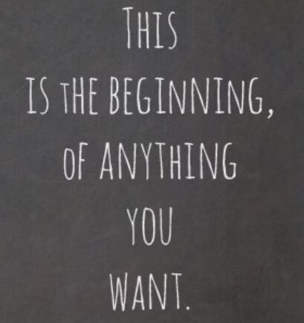
THINKING AHEAD
SYLLABUS/COURSE GOALS
PRE-COURSE ASSESSMENT

Slide 5
METACOGNITION

Slide 6
NEUROPLASTICITY

Slide 7
Your time and space
Creating and following a study schedule does not ensure effective learning.
Reflection: What are common barriers to productivity during lecture and/or study sessions?

Slide 8
Set goals for each study session
If possible, assign a space dedicated to learning
Minimize distractions
Plan for the unexpected
Plan your work, then work your plan

Slide 9
Procrastination Prevention

Slide 10
Worried about previous procrastination habits following you to college?
There's a group for that...
(this free service is linked in week 1 module)

Slide 11
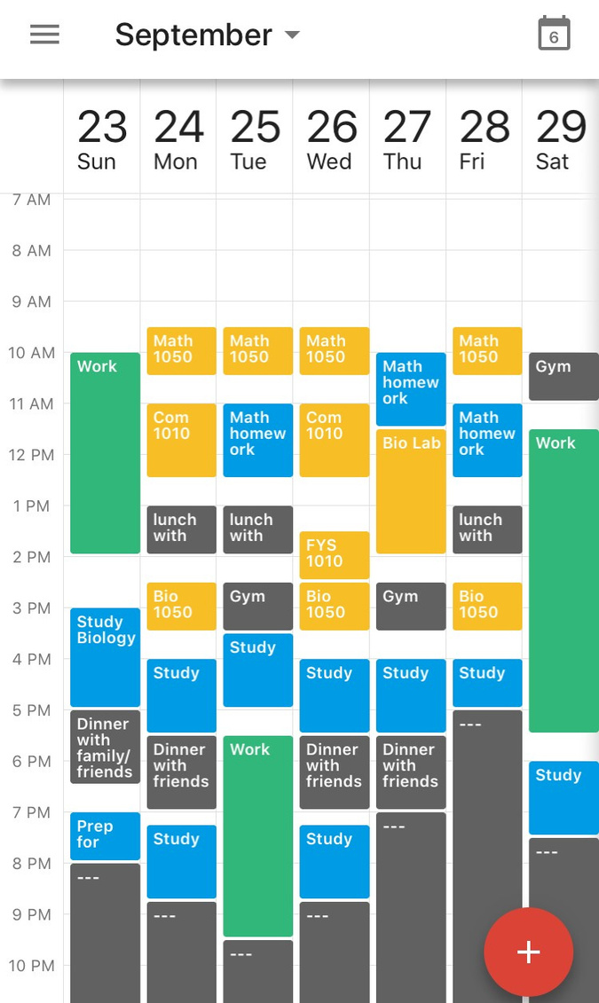
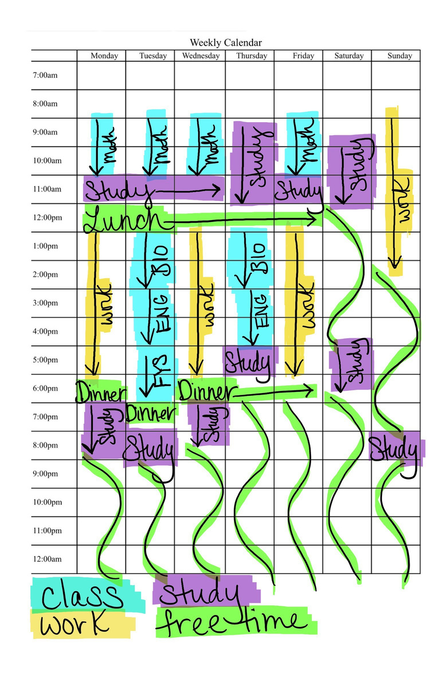
Creating a block schedule
-Google Calendar
-Microsoft Outlook
-My Study Life
-Weekly calendar (included in this week's assignment)
-Paper planner
-Bullet journaling

