Slide 1
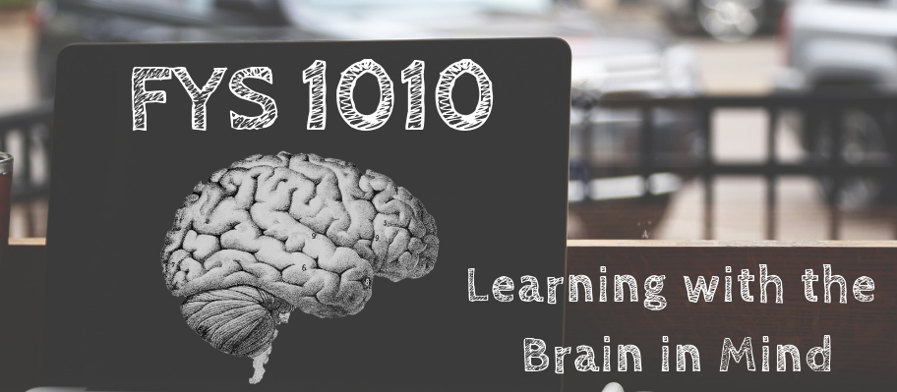
Week 3
The Brain Science Behind the A's

Slide 2
TODAY WE'LL DISCUSS
Study habits to ditch
Evidence-based study strategies
Memory as it relates to learning
Implementing the Study Cycle

Slide 3
CYCLE OF ACADEMIC DOOM
Poor grade = Zero academic motivation. Why bother?
Unable to focus in lecture...material is brand new
Major cram session. Zero sleep. Irritated at everything.
Can't focus, start to zone out...I'll teach it to myself later.
Stress and panic because exam is quickly approaching
2 weeks later, can't remember anything from that chapter

Slide 4
STUDY HABITS TO DITCH
going over your notes
cramming
aimlessly highlighting
repeatedly rereading text
trying to memorize without understanding content

Slide 5
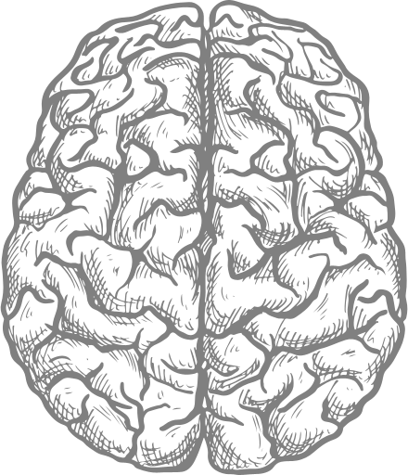
FORMULA FOR SUCCESS
test your
comprehension
short, frequent reviews
easy to retrieve material

Slide 6
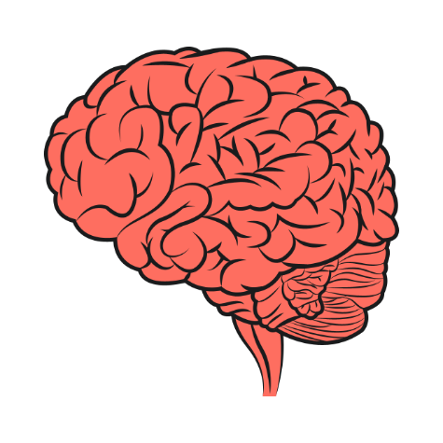
BRAIN-BASED STUDYING
Summarize in your own words
Teaching to others
Concrete examples
Spaced practice
Dual Coding
Retrieval Practice
Interleaving
test comprehension
short, frequent reviews
mix it up!

Slide 7
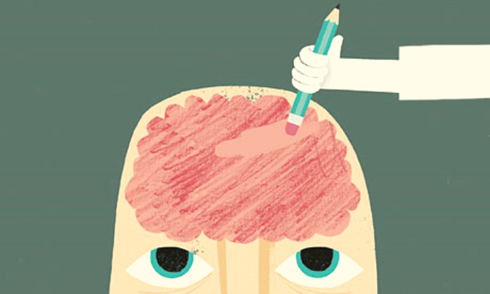
WHY WE FORGET
4 corners activity

Slide 8
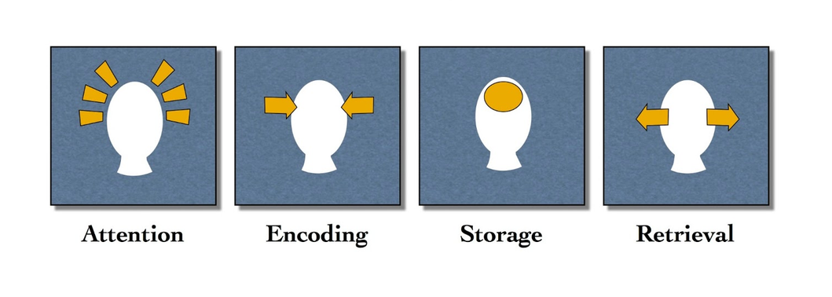
MEMORY AND LEARNING
Retrieval of learned information is essential to retain the info in the long-term memory, where it will be readily available during exams.

Slide 9
MORE IMPORTANT THAN WHAT YOU PUT INTO THE BRAIN IS HOW OFTEN YOU RETRIEVE IT.

