Slide 1
Project 4

Slide 2
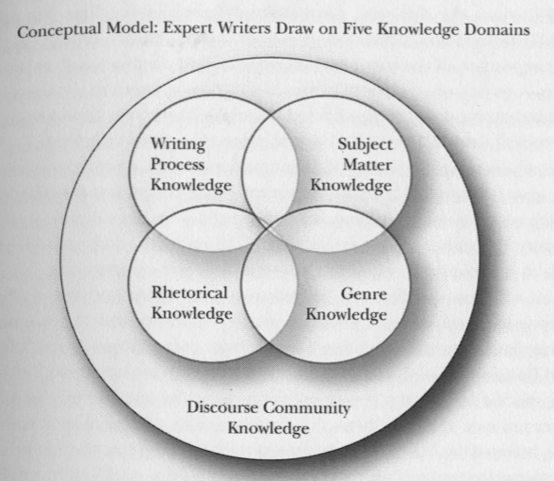
Project 4
Investigation of written intercommunication
focuses upon workplace genres
Investigation of ways of knowing and
doing within the workplace rather
than an academic setting
Beaufort’s knowledge domains

Slide 3
Project 4
Interview a Professional
Identify 3 professional genres of writing and locate samples (referring to materials from Project 1 may be useful here)
Write up 3-4 page paper that reviews your research process and analyzes the 3 genres:
How did you decide upon your 3 genres?
Where did you locate samples?
Analysis using Bawarshi: Rhetorical & Social Analysis.
Use your analysis of the genres to show what features characterize each genre, how it functions in your discourse community, how it seems to be produced, how it uses or adds to subject matter knowledge in the discourse community, and how it enacts the values and attitudes of the discourse community.

Slide 4
Analysis: Bawarshi p. 159
By performing these actions you are gathering materials to analyze and starting to think about the environment in which these writings are used
Also, do you see patterns in terms of the situation? Do all 3 of your genres “happen” in the exact same situation within your DC, or no?
First, ID and Gather:
Identify your 3 Genres for Project 4
Collect (1-2) Samples of each Genre
Then, Identify the Situation of each Genre:
Setting
Subject
Participants
Readers
Basic Motives

Slide 5
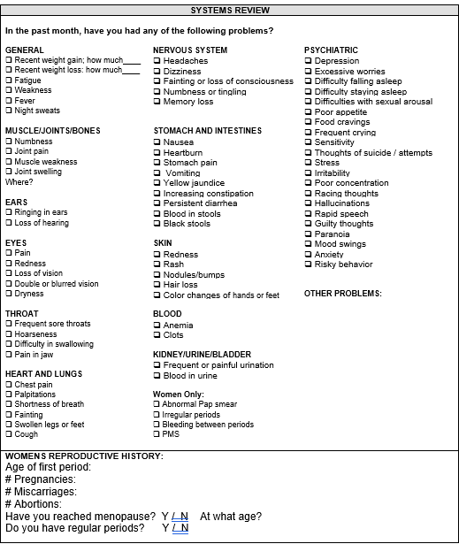
Setting
Subject
Participants
Readers
Basic Motives

Slide 6
Analysis: Bawarshi p. 160
The next part of the analysis is to look at each genre individually and identify rhetorical patterns in each genre:
What Content is included/excluded?
What examples are used?
What kinds of evidence is included?
In what ways are Logos, Ethos, Pathos included or not?
How are the genres structured/organized? What is their layout?
What is the sentence-level writing?
What specialized lexis appears?
*For this part of the project, you are looking at each genre as an isolated entity—what are choices and inclusions within each genre?

Slide 7
Lastly, analyze what these patterns reveal about their situation. This connects the rhetorical to the social.
What does each a participant need to know or believe to appreciate the genre?
Who is invited to interact with the genre? Who is not?
What values, beliefs, goals and assumptions are revealed through the patterns?
What actions does the genre make possible?
The Paper should conclude with a final reflection that ultimately answers this question:
How do the genres work to demonstrate the goals, values, beliefs, knowledge of the DC that created it?

Slide 8
Project 4
Sum Up:
Identify 3 professional writing genres used by your DC
Find 2+ samples of each to analyze
Identify the Situation of each genre
Identify the Rhetorical Patterns
Connect the Rhetorical to the Situation—how do the rhetorical choices/patterns reflect the situation? (Social Analysis)
Reflect on how the writing of your DC represents the goals, values, beliefs, knowledge of your DC
The paper should be a 3-4 page essay that covers: 1. the search process and your identification of situation and rhetorical patterns, 2. your social analysis, 3. your final reflection. his will require you to make organizational choices that allow for precision. Aim to talk about each genre on their own but the final reflection can discuss your overall conclusions. The format of the paper can be in MLA or the formatting used by your DC
Submit the essay plus your samples. Any websites or sources used to gather samples or other knowledge should be included in a standard reference page at the end of the essay (samples can be included after this in the same doc, or submitted in a separate document
Situation: Environment, Users, Subject, Motives
+
Rhetorical Analysis: Patterns in Organization, Format, Language, Appeals, Content/Evidence
=
Social Analysis: What does your analysis reveal about the relationship between these genres and the DC?
&
How do the genres work to demonstrate the goals, values, beliefs, knowledge of the DC that created it?

Slide 9
Ignite Presentation
20 slides
Auto-advance at 15 sec intervals
5 mins total
Slides should be image-based. Complement your voiceover.
Keep text on slides to a minimum
The content should mirror that of your Project 4 Essay—think of it as an outline of your essay
When presenting your genre analysis, include images of your samples

Slide 10
Drafting: 1. sketch out what you want to say first 2. practice and adapt 3. then add images and rehearse
Slide organization
Slides 1-2: introduce yourself, your DC etc.
Slides 3-4: introduce interview/sampling
Slides 5-9: Genre 1
Slides 10-14: Genre 2
Slides 15-18: Genre 3
Slides 19: Final reflection on writing in your DC
Slides 20: your URLS for all your images
*This exact organization is not required—it’s just a suggestion. Please have the first slide introduce yourself and the last slide be of your URLs, the middle is up to you

Slide 11
Ignite Submission
I recommend submitting using Zoom.
Set up the presentation with timings.
Start up a Zoom meeting.
Share screen of your presentation
Hit record on Zoom and start your presentation
Once done, stop the recording. End the Zoom session and Zoom should start the file saving process. Save the file on your computer and then submit the file to the assignment on Canvas.

