Slide 1
Final letter

Slide 2
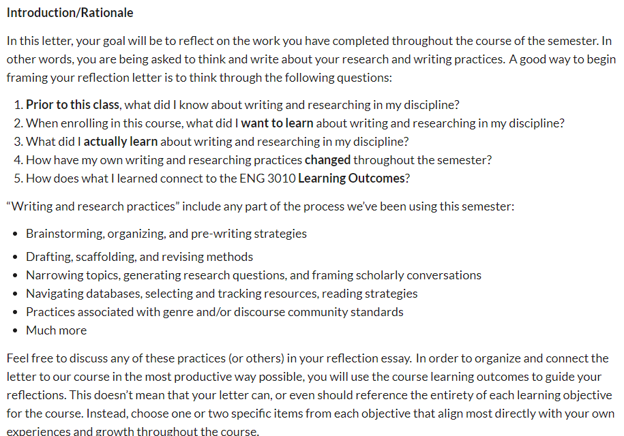
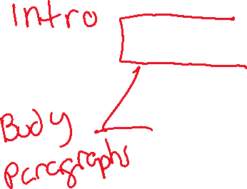

Slide 3
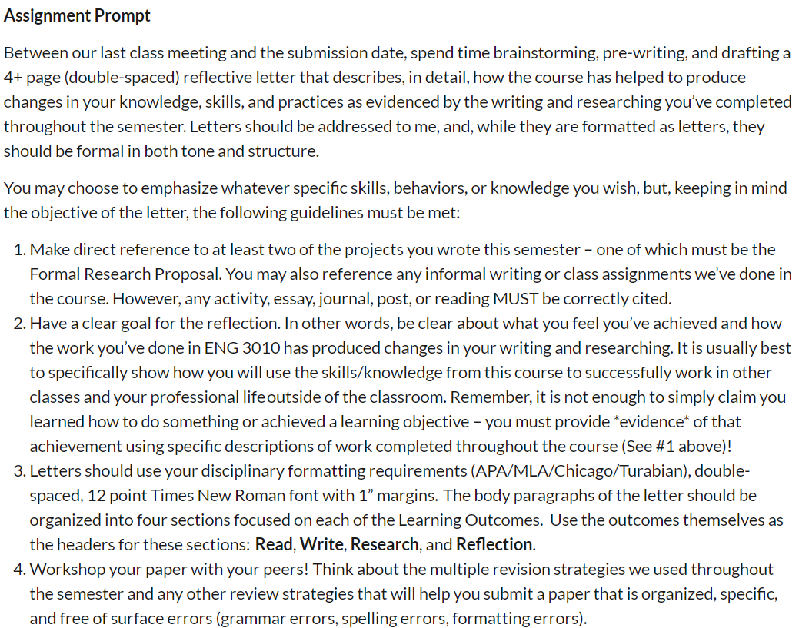

Slide 4
Letter
4 pages
Intro that covers what you knew about writing in your DC and what your 3010 expectations were
4 Learning Outcomes: Reading, Writing, Research, Reflection (use these as section headings in the Body)
Bring in commentary and proof from your Proposal and 1 other project
Style it as a letter but use correct formatting with citations that refer to page numbers in the original document
Any projects you used in the letter also need to be submitted to the assignment link
It’s really important to get this in on-time. There is a tight turnaround on grading and submitting final grades

Slide 5
